Slide 1




Miletics Pál
pmiletics@gmail.com
+36704224404

Slide 2

Mission
Notes:
We aim to be the bridge between the different players of the value-chain in order to help them finding the optimal ways to generate growth.

Slide 3
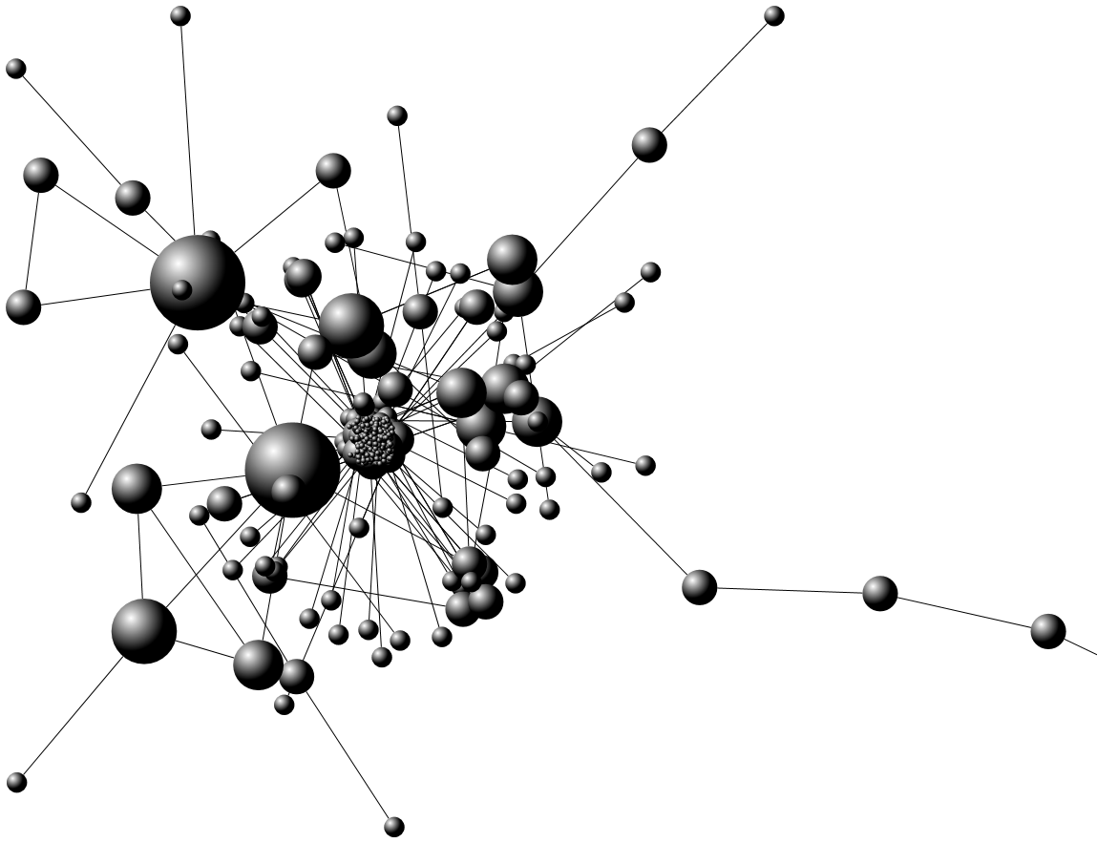
Network
Strategy
Solution
Growth
Notes:
We have a wide network of different type of players in the healthcare field.
The Accociation’s primary goal is to help its partners to create and execute successful business strategies and to explore all lucrative business opportunities within this new and booming sector.
We believe that through this network and with our strategy we are able to bring solutions for the market.
This way we will generate growth to our partners.

Slide 4

Telemedicine
Prevention

Slide 5

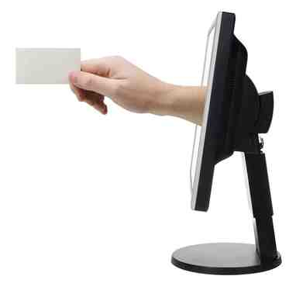

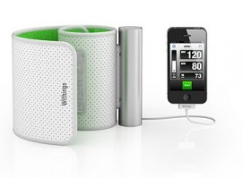
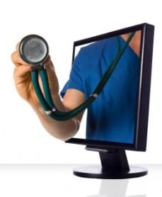
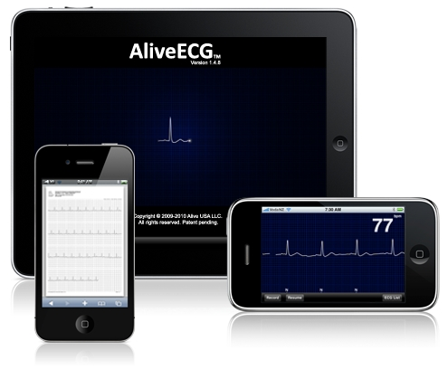

Network

Slide 6
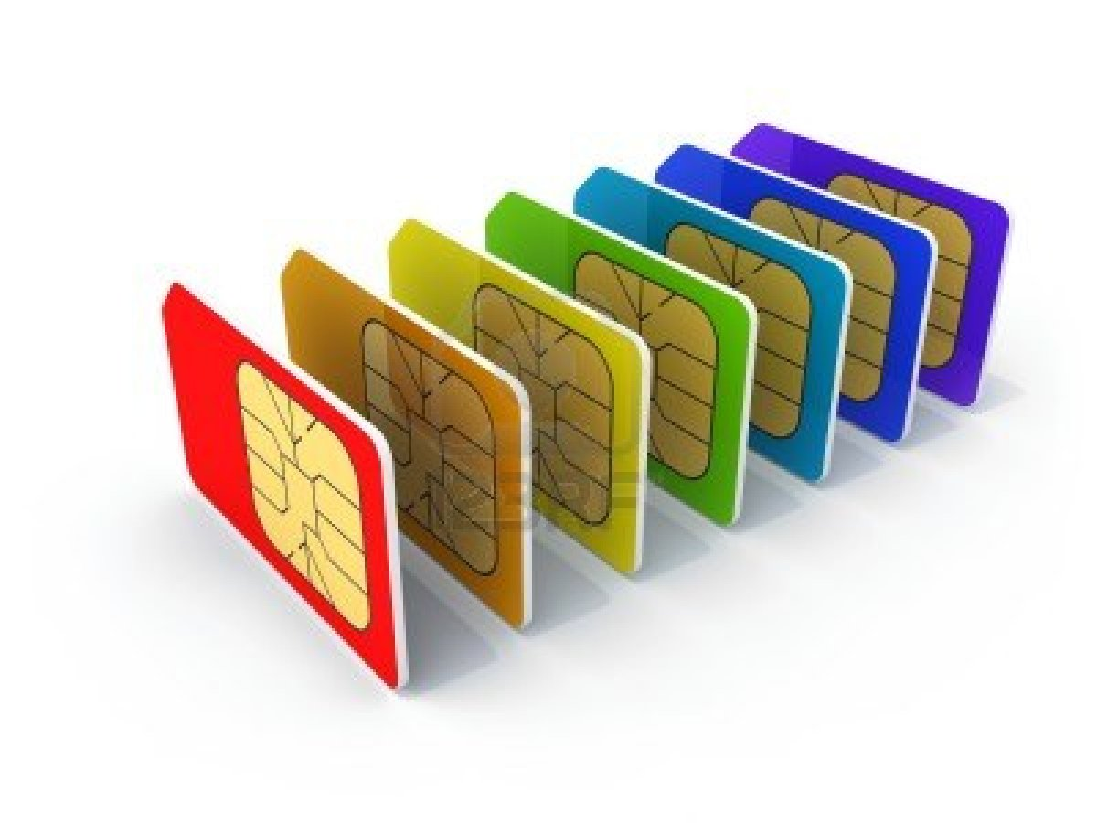
MOBILE OPERATORS
aiming to increase ARPU
Notes:
The goal for a telco/ICT company regarding the eHealth/Telemedicine business is to achieve the following:
Increase the ARPU / Decrease the churn / Enhance the retention / Offer new, innovative non-voice services / Increase data usage
We are able to offer the optimal solution based on market- and customer segmentation and research along with proven case studies.
We can involve these partners into our pilot projects with device and/or software vendors etc. as telecommunication service provider for the project. Also we can help in creating branded Telemedicine solutions

Slide 7

MEDICAL FIRMS
Planning to expand their portfolio
Notes:
For a healthcare providers the most important things are:
Increased quality of the services provided for patients and to provide new and innovative eHealth/Telemedicine solutions
Enhance the efficiency of the treatment
Increase the revenue potential on the patient-base
Broaden market-share through new solutions

Slide 8
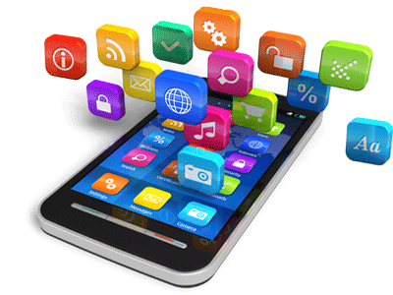
Developers
able to deliver software & applications
Notes:
Currently the market situation is that there are a lot of very good software and application developers who have started or already completed various types of telemedicine/eHealth applications. The global issue is that selling a ‘standalone’ product is almost impossible. Everyone needs a complete solution instead of just a product. This is where we are able to help:
We can assist in finding the best market opportunities where the selected application would be ideally implemented
We can assist in finding the best partners to work with that in order to put together a complex solution which includes the selected software/application
We can assist in indentifying the best channels to reach the targeted customers in the most optimal way
We can organize and manage pilot projects in living lab environments.
With the studies prepared, as a result of the pilot project, we help build the best go-to-market strategy for the device, as well as demonstrating the possible sales channels and provide sales and marketing communication advisory services to achieve the optimal outcome.

Slide 9

Cloud service providers
looking for new portfolio services

Slide 10

System Integrators
needing to increase upsell & cross-sell potential
Notes:
with significant market-share, needing new solutions in order to increase their existing upsell & cross-sell potential

Slide 11
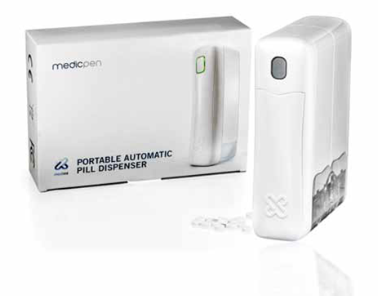
Pharmaceuticals
Compliance
Adherence
Notes:
Help them to optimize the ways and routes to reach the patient and find the right channels (e.g. pharmacies, GPs, opinion leaders, hospitals, etc.)
Support them in adherence/compliance issues
Organize and manage clinical trials, living lab pilot projects
Help them identify eHealth/Telemedicine solutions which can decrease the costs involved in sales and customer acquisitions

Slide 12

R & D
University of Szeged
University of Pannonia
Univeresity of Óbuda
Semmelweis University
Notes:
Nutrition analysis, Risk assessment, Telemonitoring Remote diagnostic
Bioelectric imaging , E-health process optimization

Slide 13
The Significance and Value of Med-e-Tel for the Global Telemedicine World

Slide 14
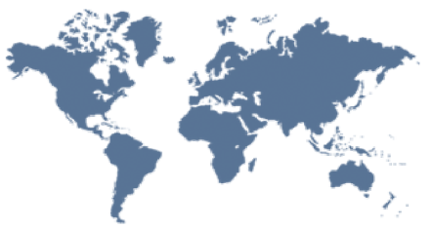

Global Implementation of Telemedicine/eHealth
NGO in Official
Relation with WHO
Graphics illustrate the results of eHealth implementation as per fall 2009 in 114 countries, 81% of the world’s population. More information is available in WHO Global eHealth Observatory Vol. 2 (2010) and Vol. 3 (2011).

Slide 15
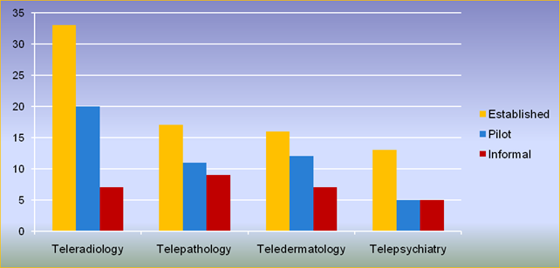
The 4 Most Widely Implemented eHealth Services
Levels of development (%):
  Established - continuous service supported through funds from government or other sources
  Pilot - testing and evaluation of the service
  Informal - services not part of an organized program

Slide 16
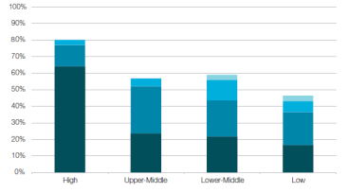
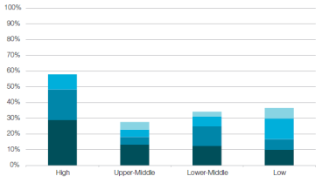
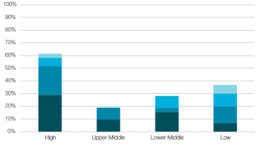
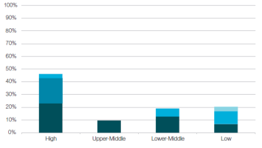
Distribution of the 4 Most Widely Implemented eHealth Services by Income Countries
Teleradiology
Telepathology
Teledermatology
Telepsychiatry

Slide 17
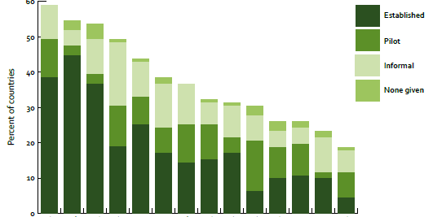
Global Distribution of Mobile eHealth:
14 Most Widespread Mobile Services
Health call center
Toll-free emergency
Emergencies
Mobile telemedicine
Appointment reminder
Community mobilization
Treatment compliance
Patient records
Information
Patient monitoring
Health surveys
Surveillance
Awareness raising
Decision support

Slide 18


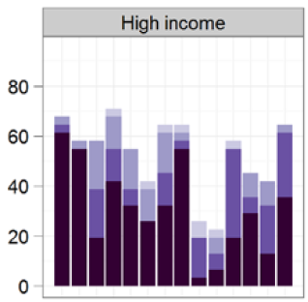
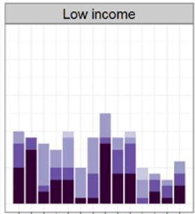

Distribution of the 14 Most Widespread Mobile Services by Income Countries
Call center
Toll-free emergency
Treatment compliance
Appointment reminder
Community mobilization
Awareness raising
Mobile telemedicine
Emergencies
Health surveys
Surveillance
Patient monitoring
Information
Decision support
Patient records
Call center
Toll-free emergency
Treatment compliance
Appointment reminder
Community mobilization
Awareness raising
Mobile telemedicine
Emergencies
Health surveys
Surveillance
Patient monitoring
Information
Decision support
Patient records

Slide 19



WABT
PARTNERS
UNESCO NGOs
Non-Governmental
Organizations
WABT I C I T
MDGs UATI – ICET
Committee
ORLD
WABT S D
STRATEGY & FINANCE
Innovation Technology
Enterprises
Creative Clusters
W A B T
CADEMY
ioengineering
iotechnology
WORLD BioMiNT
BINT Incubator
iomedicine
ECHNOLOGIES
UNESCO House
1, Rue Miollis
F-75732 Paris Cedex 15
Tel.: 00 33 (0)1 45 68 48 27
Fax: 00 33 (0)1 43 06 29 27
www.wabt-house.org
www.wabt.com.fr
wabt@unesco.org

Slide 20

First time WHO Global Observatory for eHealth surveyed members on mHealth
Survey completed by 114 countries
Documents adoption of initiatives, types of initiatives, status of evaluation & barriers to implementation
Surveyed 14 categories of mHealth services including:
  health call centers
  emergency toll-free telephone services
  managing emergencies and disasters
  mobile telemedicine
  appointment reminders
  community mobilization & health promotion
  treatment compliance
  mobile patient records
  information access
  patient monitoring
  health surveys and data collection
  Surveillance
  health awareness raising
  decision support systems
http://www.who.int/goe/publications/goe_mhealth_web.pdf

Slide 21
“m-Health has the potential to revolutionise affordable healthcare delivery by alleviating the systemic pressures on the healthcare industry”*
* http://connectedplanetonline.com

Slide 22
Why m-health promises to be a winning solution
Low network maintenance
Remote monitoring in rural areas
Phones are always on, computers are not
Carrying a Phone/Tablet is part of a modern lifestyle
Using a small portable multi-communication computing device is convenient, economical, practical and personal

Slide 23
m-health as a ‘developing world’ solution
Examples of m-health initiatives – Argentina, Botswana, China, Guatemala, India, Indonesia, Kenya, Mozambique, Nigeria, Pakistan, Peru, Philippines, Rwanda, South Africa, Tanzania, Uganda, Zambia
Issues include:
Dealing with epidemics and a shortage of healthcare workers
Largest killer diseases - malaria and AIDS
Opportunities:
explosive growth of mobile communications over the past decade offers a new hope for the promotion of quality healthcare
Phones offer a management platform for administration and monitoring of anti-retroviral treatment programs
Foundations to address the developing world’s health crisis set up by such philanthropists as Bill Gates

Slide 24
Why Is mHealth Important?
Growth of mobile phone subscriptions
Mobile phone subscriptions (per 100 people) | 2005 | 2010 | Growth (%)
Low income countries | 4.6 | 33.3 | 624
Middle income countries | 26.9 | 78 | 190
High income countries | 84.2 | 110.8 | 32
(Source: World Bank and International Telecommunication Union 2012)
Notes:
In 2011, there were 5.9 billion mobile subscribers worldwide out of the estimated 6.9 billion people - corresponding to a global mobile phone penetration of 87%. Almost 80 percent of mobile subscribers live in the developing world. Mobile phones are seemingly everywhere, and the growth of mobile phones is being driven by demand in developing countries. In 2010 alone, developing countries saw a 20% annual growth rate in mobile subscriptions with no signs of slowing down (ITU 2012a; World Bank 2011). From 2005 to 2010 mobile subscriptions in developing countries grew 221% (ITU 2012b).
One factor driving increased growth rates is price. Across the globe, telecommunications as well as Internet services are becoming more affordable. Between 2008 and 2011, the price of ICT services dropped by an average of 30% (ITU 2012c).
While the mobile market is reaching saturation in developed countries, mobile phone penetration is expanding in developing countries. Between 2005 and 2010 the growth rate of mobile phone subscriptions (measured per 100 people) grew by over 100% in Europe. However, in Sub-Saharan Africa, mobile telephone subscriptions grew by 274% while South Asia had a staggering 665% increase. When examining increases in mobile phone penetration by income group, it is clear that the rapid pace of growth worldwide is driven by low income countries (World Bank and ITU 2012).

Slide 25
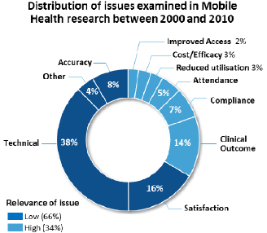
1st Generation Projects Established Usability
(Source: GSMA 2012)
Notes:
1st generation mHealth programs have yielded more evidence on usability and less evidence on impact. The research has predominantly focused on demonstrating that the technology for mobile health works from a technical perspective and that end users like to use mobile health solutions.
Although the mHealth evidence-base is growing, there are major research gaps. We’ve done a lot of pilot mHealth programs to test out the waters and see what is possible.
Now we need to move to use of rigorous research designs that look at impact on health outcomes. We need to better focus and generate evidence on the factors that drive adoption.
These include the efficacy of clinical outcomes; cost comparisons; and the influence of mobile health on the wider healthcare system (i.e. reduced hospital attendance, resource utilisation, or improved access). These will be some of the main focus in 2nd generation mHealth programs.

Slide 26
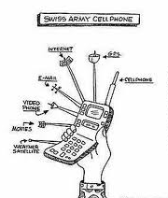
1st Versus 2nd Generation Programs
Voice
Text
Email
GPS
Music
Video
Internet
Apps
Notes:
We can think about 1st versus 2nd generation mHealth programs.
1st Generation mHealth Programs
Single function of mHealth program, silo’d
Fragmentation and duplication in data collection
HIS not used at local level
Data collection is a burden as detracts from time spent delivering services
Little integration of systems
SO: in their 2011 report, the WHO estimated that about 2/3 of mHealth programs are pilots (excluding call centers and emergency management)
2nd Generation mHealth Programs
Health encounter data used to inform policy, but also to improve care at point of service
Mobile devices become key in HIS
One device has multiple functions
And the ability to communicate with numerous electronic data systems
Greater scope, scale, sophistication
THE FUTURE: Moving toward a model like the “Swiss Army Cellphone”

Slide 27
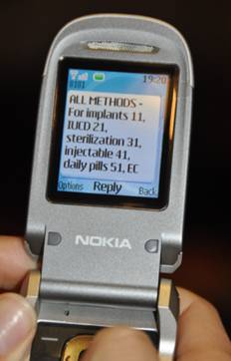
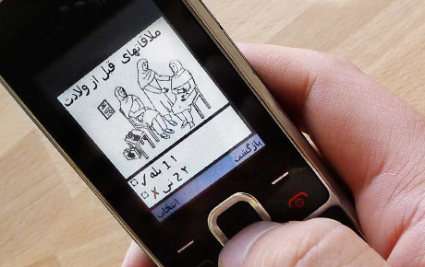
Categories of mHealth Programs
1. Client-centered
2. Health system strengthening
Notes:
While mhealth programs can be categorized in many ways, in general they fall into two broad categories of practice: client-centered and health system strengthening. However, many programs straddle these categories, and programs are increasingly integrating multiple functions in one tool.
Client-centered programs provide health information and support directly to clients or the general public. These include health education, patient adherence, and patient monitoring programs. Examples include m4RH and CycleTel.
Health system strengthening programs include training for health workers, job aids and other point-of-care support for health workers, supply chain management, and data and support for health systems and program management. Examples include the CommCare platform and ILS Gateway.

Slide 28
What is the Impact of mHealth?
Evidence on client-centered programs
  Text message programs have high acceptability and may be effective for behavior change
Evidence on health system strengthening programs is sparse and still emerging
  Improved treatment compliance by health workers
  Supply change management
  More efficient delivery of community health services
(Sources: Deglise 2012, Cole-Lewis 2010, Gurman 2012, Horvath 2012, de Tolly 2012, Gold 2010, Florez-Arrango 2011, Zurovac 2012, Barrington 2010, Lemay 2012, L’Engle et al. 2012, Castano et al. 2012.)
Notes:
Evidence on client-centered programs:
Text message programs may be effective for behavior change
Access to and sharing phones, language, literacy, technology challenges are important considerations
More information needed on best practices for developing content
Evidence on health-system strengthening programs is very sparse. Emerging evidence suggests:
Health worker reminders about protocol guidelines result in better treatment compliance.
mHealth can be used for supply chain management and more efficient delivery of community health services
Issues around encouraging HCPs to use these tools, and how to better link to health information systems

Slide 29
Peer Reviewed Evidence on mHealth for Family Planning
Knowledge for Health (Malawi)
  SMS, phone calls are 4 times cheaper and 134 times more efficient than traveling to talk with supervisors
Mobile for Reproductive Health (Tanzania)
  FP information can be delivered via mobile phone to different population segments
  Has potential to impact contraceptive use
  Effect of daily SMS on OCP continuation (USA)
  At six months, women in intervention group were significantly more likely to continue OCPs
(Sources: Lemay 2012, L’Engle et al. 2012, Castano et al. 2012.)
Notes:
K4Health (Malawi)
K4Health designed an 18-month demonstration project intended to test different ways to improve the exchange and use of FP/RH and HIV/AIDS knowledge within the health system in Malawi. The project intervention included development of an SMS network to improve communication and information sharing among CHWs and communication between CHWs and district teams. Findings indicate that the SMS messages and phone calls are at least four times cheaper and at least 134 times more efficient in getting feedback than traveling to communicate directly with supervisors at the district level.
Mobile for Reproductive Health - m4RH program (Tanzania)
Mobile for Reproductive Health (m4RH) is an opt-in interactive and menu-based SMS system that provides automated information about eight different FP methods. m4RH messages are free to the user and available across all cell phone providers. During a 10-month pilot, m4RH was promoted in a small number of FP clinics in Tanzania. Evaluation results suggest that FP information can be feasibly delivered via mobile phone, may reach different population segments, and has the potential to impact contraception and condom use behavior.
Effect of daily text messages on OCP continuation (USA)
At one family planning health center in New York City, young women who elected oral contraceptive pills were randomized to routine care or routine care plus 180 days of daily educational messages by SMS. Educational messages were adapted from a pamphlet on OCP risks, benefits, side effects, use, effectiveness, and mechanisms of action. At six months, women in the intervention group were significantly more likely to continue oral contraception compared with the control group.

Slide 30
Evidence on mHealth for Other Topics
SEXINFO (USA)
  Text messaging is an acceptable way for youths to receive information and service referrals
Mobile technologies improve adherence to ART in Africa (Kenya, WelTel Kenya)
  Wired Mothers (Zanzibar)
    SMS reminders increased skilled delivery attendance
  Effect of mobile phone reminders on health workers’ adherence to malaria treatment guidelines (Kenya)
    SMS reminders improved malaria case management
(Sources: Levine et al. 2012, Pop-Eleches et al. 2012, Lester et al. 2012, Lund et al. 2012, Zurovac et al. 2012.)
Notes:
SEXINFO. Key finding: Text messaging is a feasible and acceptable way for youths to receive information and service referrals.
SEXINFO is an opt-in text messaging service which provides basic facts about sexual health and relationships, as well as referrals to youth-oriented clinical and social services for at-risk youths in San Francisco, California. In the first 25 weeks of service, youth frequently accessed information related to STIs and pregnancy, and evaluation data showed positive associations between demographic and geographic risk factors for STIs and campaign awareness.
Antiretroviral treatment adherence, Kenya. (Two studies). Key Finding: SMS reminders improved ART adherence.
Pop-Eleches et al. (2011): At one rural health center in Kenya, new ART patients assigned to an intervention group received either short or long SMS reminders at a daily or weekly frequency. Weekly SMS reminders increased the percentage of participants achieving 90% adherence to ART by 13-16% compared with no reminder.
Lester et al. (2010): At three clinics in Kenya, HIV-infected adults initiating ART randomized to a mobile phone SMS intervention received weekly text messages to inquire about their status and to remind them about the availability of phone-based support. Self-reported ART adherence was significantly better in the SMS group compared with the group receiving standard care.
Wired Mothers. Key Finding: SMS reminders increased skilled delivery attendance.
At selected primary health care facilities in six districts in Zanzibar, women attending antenatal care at an intervention health facility received an SMS intervention that provided simple health education and appointment reminders to encourage attendance to routine antenatal care, skilled delivery attendance and postnatal care. The mobile phone intervention was associated with an increase in skilled delivery attendance, particularly among urban women.
Mobile phone reminders and adherence to treatment guidelines. Key findings: SMS reminders improved the quality of pediatric malaria case management.
This study tested (in 11 rural districts) whether text message reminders sent to health workers’ mobile phones could improve and maintain health workers’ adherence to national guidelines for the management of outpatient pediatric malaria.

Slide 31
Evidence on mHealth for Other Topics
(continued)
Mobile rich media job aids for CHWs (Columbia)
  Rich media clinical guidelines reduces CHW errors
SMS for life (Tanzania)
  SMS reporting reduced stock-outs of anti-malarials
  Impact of mhealth intervention for peer health workers on AIDS care in rural Uganda
    Reporting on patient-specific clinical information showed no improvement in outcomes
(Sources: Florez-Arrango et al. 2011, Barrinton et al. 2010, Chang et al. 2011)
Notes:
Performance factors of mobile rich media job aids for CHWS. Key Findings: Rich media clinical guidelines on mobile hones reduces CHW errors.
This study investigated the possible benefit on performance of 50 CHWs of point-of-care clinical guidelines implemented as interactive rich media job aids on small-format mobile platforms. The intervention reduced errors by 33% and increased protocol compliance by 30%.
SMS for life. Key Findings: SMS reporting reduced stock-outs of anti-malarials.
SMS for Life, a 21-week pilot study involving 129 health facilities in three rural districts, used mobile phones to facilitate accurate stock counts of anti-malarial medications. The pilot provided visibility of anti-malarial stock levels to support more efficient stock management using simple and widely-available SMS technology.
Impact of a mhealth intervention for peer health workers on AIDS care in rural Uganda. Key Findings: Reporting on patient-specific clinical information showed no improvement in outcomes.
Peer health workers in the mHealth intervention group used phones to call and text higher level providers with patient-specific clinical information. The intervention group did not perform better than the control group on virologic, adherence, mortality, or retention outcomes, although qualitative analyses found improvements in patient care and logistics and broad support for the mHealth intervention within the health system

Slide 32
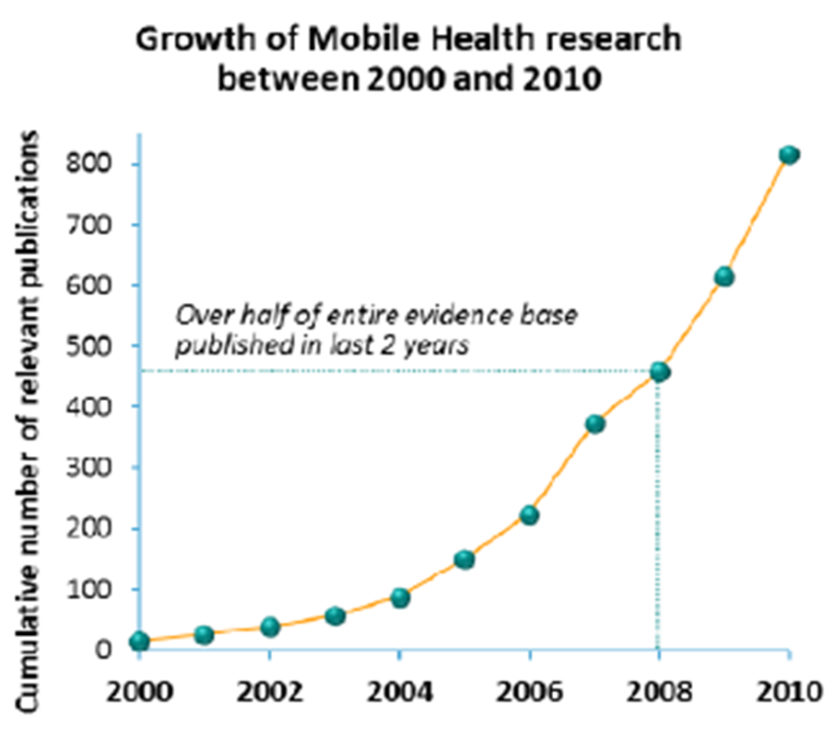
Moving Forward:
Priorities for mHealth Research
Rigorous evidence and best practices are needed for:
Impact of mhealth on clinical and behavioral outcomes
Cost effectiveness and cost benefits of mhealth tools
Influence of mhealth on the wider healthcare system, particularly at scale
Conditions for and enablers of successful scale-up of mhealth
(Source: GSMA 2012.)

Slide 33
The Omron case – an eHealth project

Slide 34
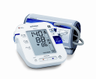

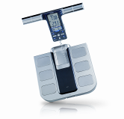
Omron
HQ in Kyoto, Japan
32.000 Employees world wide
4,8 Billion EUR (Net sale)
Business areas
Industrial Automation
Electronic Components
Medical Equipment
  for Personal use such as blood pressaure, Pedometers, Body Composition Monitors etc
  for Professional use such as Blood pressaure, Non Invasive Vascular Monitors, portable ECG’s etc

Slide 35
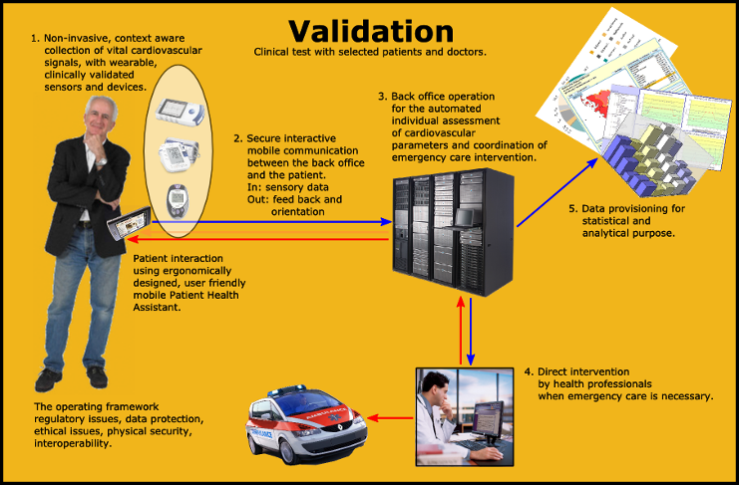
The complete solution

Slide 36
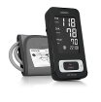



Medistance :Telenor Hungary – Omron
First, secure, safe, simple mobile remote healthcare for elderly, chronic patients
Validated OMRON IT Blood Pressure Monitor
Validated IT Multicare Glucose Monitor
Validated IT OMRON ECG
Validated OMRON Body Fat Monitor
Pilot in Szabolcs Szatmár Bereg county: : http://www.youtube.com/watch?v=oLk5VEoGa9k
480 pcs Medistance devices
9 months long, in 5 clinics, 180 patient
30% cost saving

Slide 37
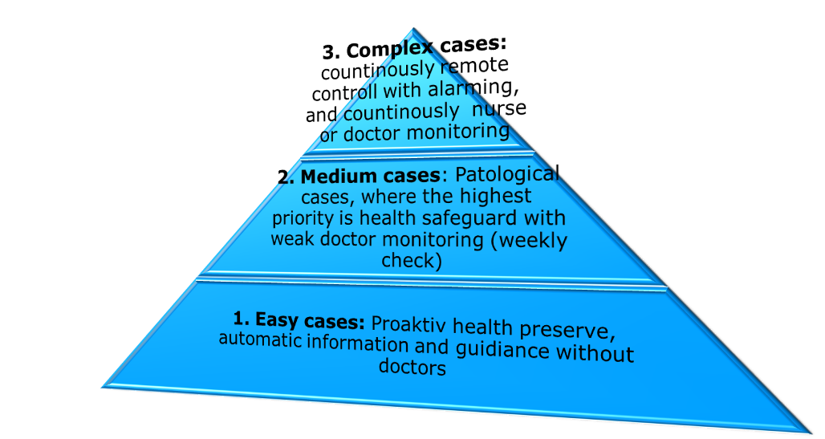
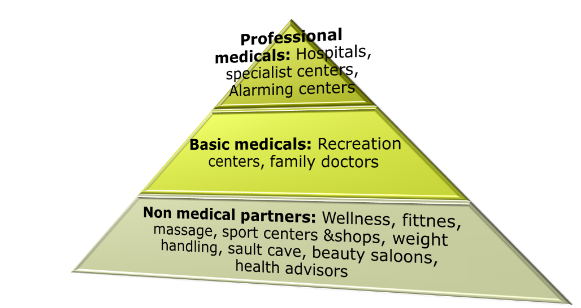
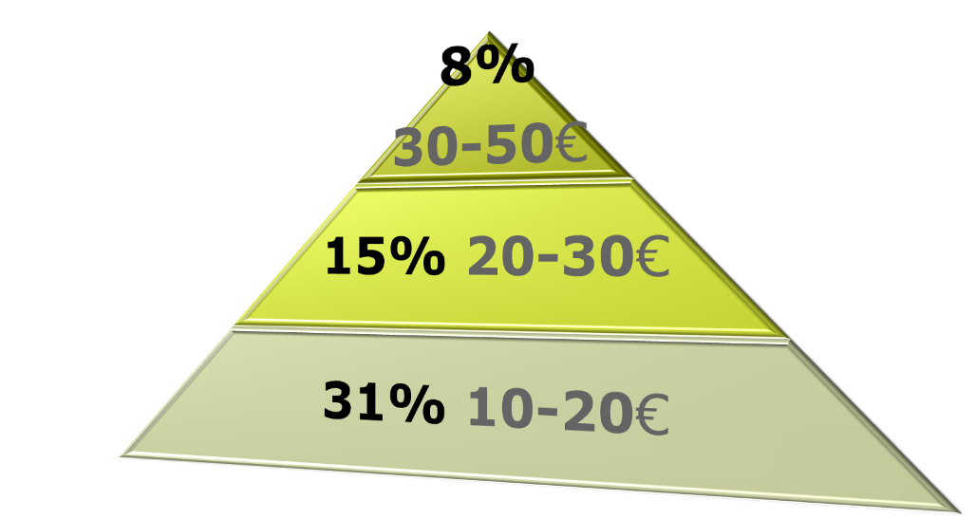
Go to market
Pyramid of business model vs. partners
Market potential, monthly fee in Euro
(including device+HW one time fees)

Slide 38
Pilot
Szabolcs Szatmár Bereg county
http://www.youtube.com/watch?v=oLk5VEoGa9k

Slide 39
Health in the future: Europe 2020
A smart, sustainable and inclusive economy
  75% of the 20-64 year-olds to be employed
  at least 20 million fewer people in or at risk of poverty and social exclusion
  3% of the EU's GDP (public and private combined) to be invested in R&D/innovation
  greenhouse gas emissions 20% lower than 1990
  20% of energy from renewables
  20% increase in energy efficiency
  Reducing school drop-out rates below 10%
  at least 40% of 30-34–year-olds completing third level education

Slide 40
7 Flagship initiatives
Innovation Union - (including healthy and active ageing)
European platform against poverty and social exclusion (including health inequalities, and mental health)
Youth on the move
Resource-efficient Europe
An industrial policy for the globalisation era
An agenda for new skills and jobs
Digital Agenda for Europe

Slide 41


Health in Europe 2020: Innovation platform for healthy and active ageing
increase healthy life years by 2 years by 2020
Innovation in health technology and health systems

Slide 42
Challenges to health care sector
Health promotion and prevention
Strengthen cooperation with other sectors – social care, employment, education
Fair cost containment.

Slide 43
Preventable chronic diseases
No diseases
Risk factors
Genetic
predisposition
Diseases
Primary
Prevention:
Population
Tertiary
Prevention:
Patients
Nutrition
Alcohol
Secondary Prevention:
Risk groups
Drugs
Cancer screening
CVD
…

Slide 44

A reflection process on chronic diseases
Promotion/prevention/
treatment
Citizen/patient/professional
Individual/societal
Research/Innovation
EU/national/local
Public policy/stakeholders

Slide 45

We can assist in finding the best market opportunities
Network
Strategy
Solution
Growth

Slide 46
Thank you for your attention!
Miletics Pál
pmiletics@gmail.com
+36704224404

